Slide 1
SENG 438 Software Testing, Reliability & Quality
Chapter 1: Introduction
Department of Electrical & Computer Engineering, University of Calgary
B.H. Far （far@ucalgary.ca）
http://people.ucalgary.ca/~far

Slide 2
Introduction
Instructor
Name: Behrouz Far, Professor, PhD., PEng.
Homepage: http://people.ucalgary.ca/~far/
E-mail: far@ucalgary.ca
Email subjects should start with “SENG 438 – “ followed by your own title
Office hours: Tuesday and Thursday mornings
Course
Name: Software Testing, Reliability and Quality
Homepage: http://d2l.ucalgary.ca/
Course TAs: Fatemeh Sharifi, Munima Jahan
Class hours: Lecture: Tuesday, Thursday – 3:30 pm – SA 104
Lab: Wednesday – 1:00 pm – ICT 319/320

Slide 3
Relationship to Other SENG Courses
Will “touch” testing. But will not teach it. Instead, will use the concepts we learned here.
ENSF 480
SENG 438
ENSF 337
ENSF 409
SENG Course Flow Diagram (only the core courses)

Slide 4
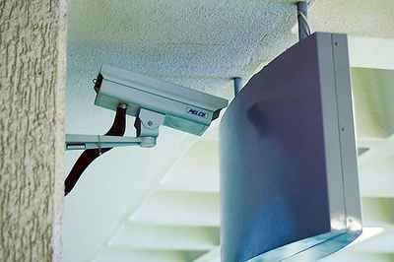
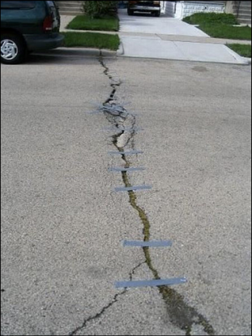
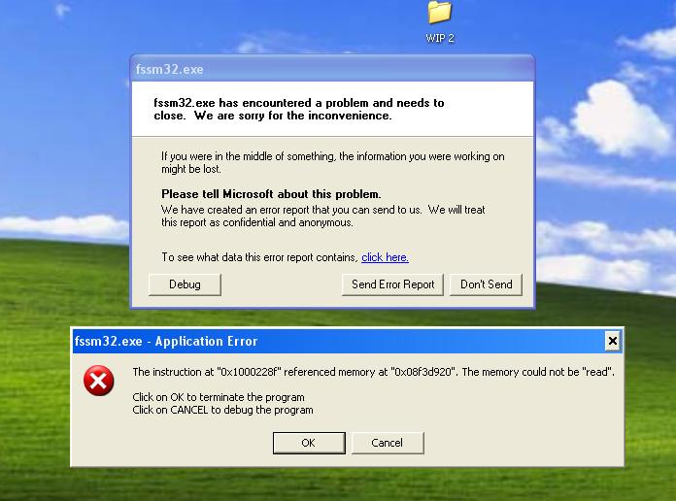
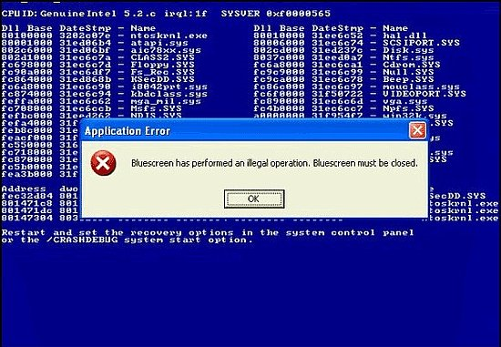
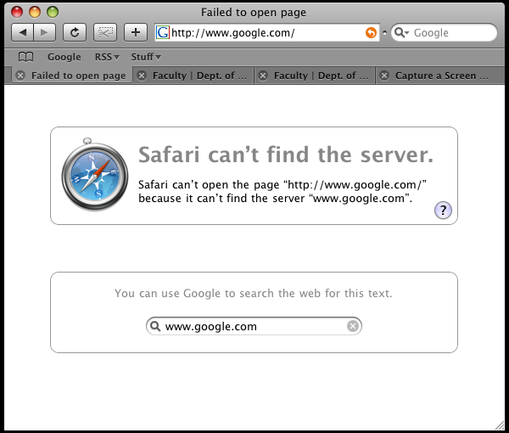
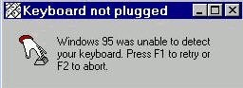
Contents
Shorter version:
How to avoid these?
Notes:
• Software glitches/ problems/ defects/ bugs are everywhere!
• We will learn how to effectively and efficiently find them in this course

Slide 5
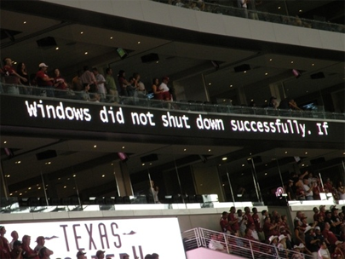
Contents
Longer version:
What is software testing, reliability and quality?
What is software testing and reliability engineering process?
How to test a software system and assess test adequacy?
How to assess quality of a software system?

Slide 6
Objectives
Understanding fundamental of software testing, reliability and quality
Understand software testing and reliability engineering process
Understand software design with quality mind set
Have an overview of the careers outlooks of software testing and quality assessment
Gain experience working in a software testing team
Designing test cases and improving test suites
Understand test planning process, test selection and prioritization strategies
Assess test adequacy using test coverage metrics
Assessing reliability and quality of software
Use test tools and frameworks and track quality during development and post-release

Slide 7
CEAB Graduate Attributes
Each course has its unique signature
In SENG438 we focus on 3 main GAs
A1. A knowledge base for engineering A7. Communication skills
A2. Problem analysis A8. Professionalism
A3. Investigation A9. Impact of engineering on society/environment
A4. Design A10. Ethics and equity
A5. Use of engineering tools A11. Economics and project management
A6. Individual and team work A12. Life-long learning
The level at which the learning outcome is addressed in this course:
I (Introduced): Introductory level
D (Developed): Intermediate development level
A (Applied): Advanced application level

Slide 8
Theory + Practice
We need to mix Theory and Practice in this course
Theory, Research
Practice
This Course
Concepts, Foundations
Tools
Lectures
Midterm and Final Exam
Labs
Project
Practical Engineering course
Novelty of problem; multiplicity of solution

Slide 9
Course Delivery
GoF (Good Old Fashion) style Lectures/Labs
Competitive and energetic learning environment
No flip, flop, summersault, etc.!
No non-sense entertainment, no info-tainment, no monkey business!
Attend lectures and labs: there is more to lectures than to the slides and notes

Slide 10
What Do You Need to Know?
Java programming language
You will test Java applications
You will develop test cases in the Java environment
Basics of software engineering
Teamwork
You are going work as a team in the Lab, so be a team player

Slide 11
Detailed Contents
Ch1: Introduction & terminology
Ch2: Foundations of testing
Ch3: Unit testing
Ch4: Black box & combinatorial testing
Ch5: White box testing: control and data flow coverage
Ch6: Mutation testing
Ch7: GUI/Web testing and test automation

Slide 12
Contents (cont’d)
Ch8: Reliability engineering concepts and process
Ch9: System reliability
Ch10: Reliability testing tools and techniques
Ch11: Integration, system, acceptance testing and release decisions
Ch12: Post release activities: planning for software maintenance

Slide 13

Assignments
5 assignments (2 weeks each)
A1: Bug tracking
A2: Unit testing using Junit
A3: Test coverage and adequacy
A4: Mutation, GUI and Web testing
A5: Reliability assessment

Slide 14
Assignments - Policies
5 assignment in 10 labs (each lab for 2 weeks)
Each assignment will be discussed first in class/lab
In lecture time – or – beginning of lab hour
The descriptions will be online before the first lab on each assignment
Come to lab prepared: you are expected to read the lab document before coming to the lab
Demos in the second lab per assignment
Reports by the due date of second lab per assignment (exact dates will be posted)
One mini-project: A small developed software will be given
You do the test, assessment and report (details later)

Slide 15
Lab Activities
This is a practical/lab-intensive course
Usually, you need to spend a few hours out of the lab scheduled time to finish each lab
Note that we care (and are very careful) about your workload
The goal: to prepare you for the software industry
Other than the lab times, if you have questions, contact TAs, post on D2L, or email instructor
Watch for office hours posted

Slide 16
Lab Activities: Late Reports
Carefully check the labs schedule for report due dates. Late lab reports will not get any marks
We (the TAs and myself) are here to work with and help you!
Rest assured that the testing knowledge you gain in these labs prepare you for a real testing job
The labs have recently been designed in consultation with the software industry, and with the help of a few recent top students

Slide 17
Lab Activities: Groups
All labs and the project will be done in groups
Please form your groups of four by the due date and post it on D2L under “Dropbox–Groups”
One person submits on-behalf of all
Write full name
All students not finding any group by then will be randomly grouped

Slide 18
Lab Activities: Demos
Each second lab per assignment is demo-day
E.g., Assignment 1 will be done in Lab 1 and completed by Lab 2. during Lab 2 you demo your work and by the due date you submit your assignment 1’s report, as a team
The purpose of demo is to assess completeness and individual’s contribution
The exact detail of what/how to demo will be explained in each assignment description

Slide 19
Project Presentation & Report
The last week is for the project demo and report
Last lab (Lab 11) and, if needed, the last two lecture hours
As a team you present your project
A short report must be submitted by the last day of classes

Slide 20
Group work: Very Important
It is the team’s responsibility to distribute their tasks evenly and deliver high quality reports and demos
If you face any problem with individuals not working as they should, you must report it to the TAs and me, ASAP.
We assume everything is fine and everybody contributes the same, if you don’t report
We can not help if you don’t report on-time
If a student does not contribute enough their project/assignment mark may be less than their teammates

Slide 21
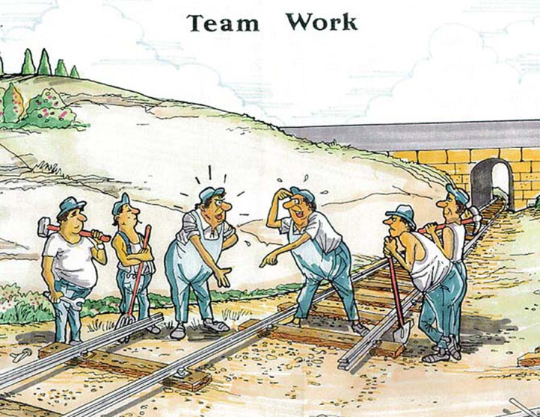
Why Group Work?
This is how you will work eventually in real life
You will always have people in your team that are not either as good as you or they are better than you
You still need to manage the situation and deliver high quality material on-time

Slide 22
Missing & Deferrals
University rules will be strictly followed
If you miss a lab or need more time to submit your report for a legitimate reason
such as illness, or a serious personal issue
Please email and provide the instructor with proper documentation ASAP to arrange an adjustment

Slide 23
Examinations
The exams questions will be a mix of concepts, definitions and problem-solving questions
We will review sample questions before the exams, in class
The midterm will be held, during regular lecture times
The exact dates and the topics to be covered by each exam will be available on D2L later in the term

Slide 24
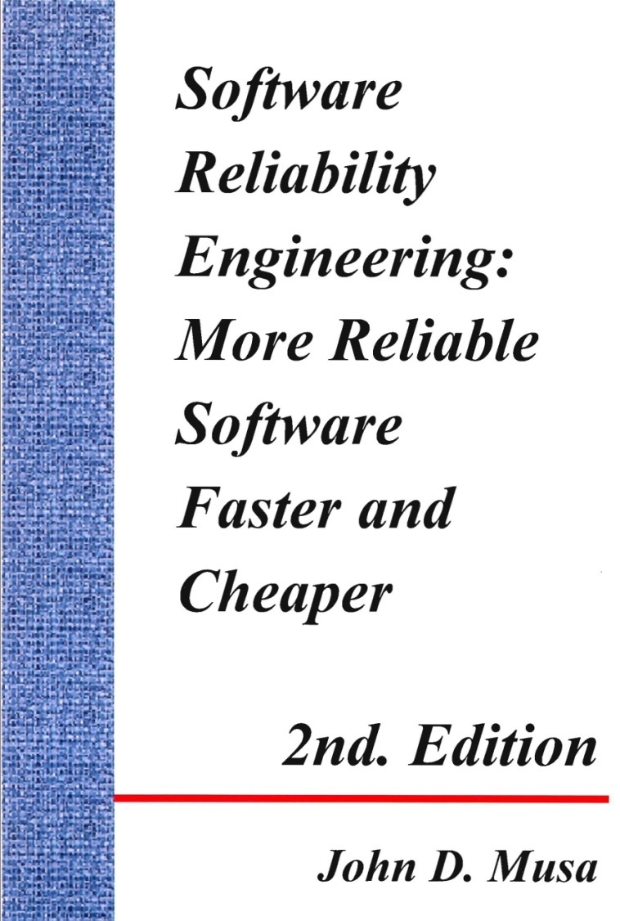
Books and Textbooks
Good news! There are NO required textbooks for this course
We will learn from a selection of books
Some recommended books:

Slide 25
Books and Textbooks
The book is available full-text for FREE (from UofC IP addresses).
http://proquest.safaribooksonline.com.ezproxy.lib.ucalgary.ca/book/software-engineering-anddevelopment/software-testing/9788131707951

Slide 26
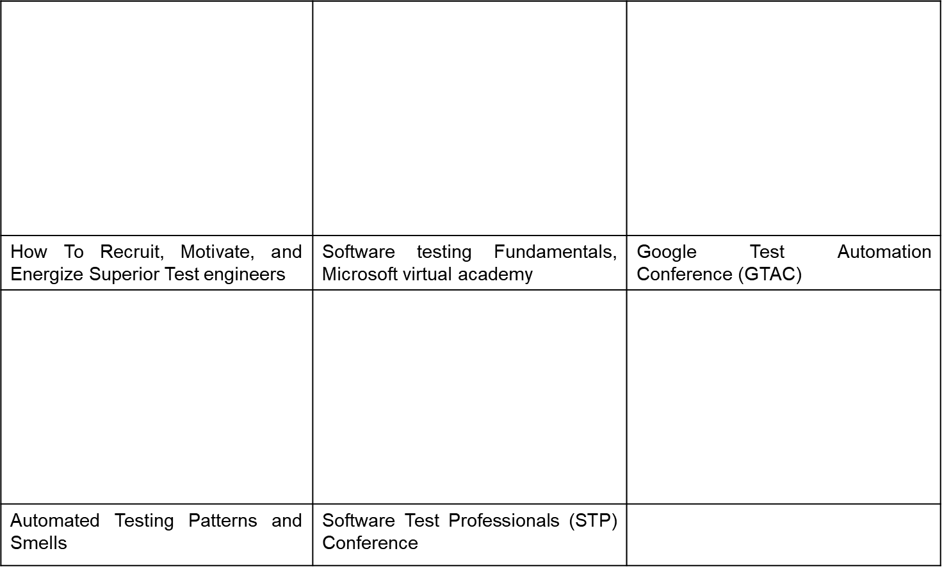
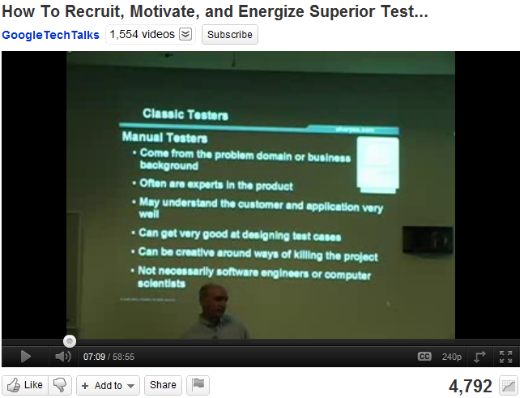
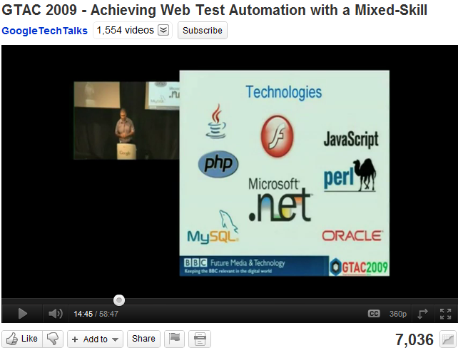
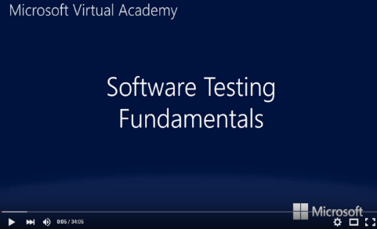
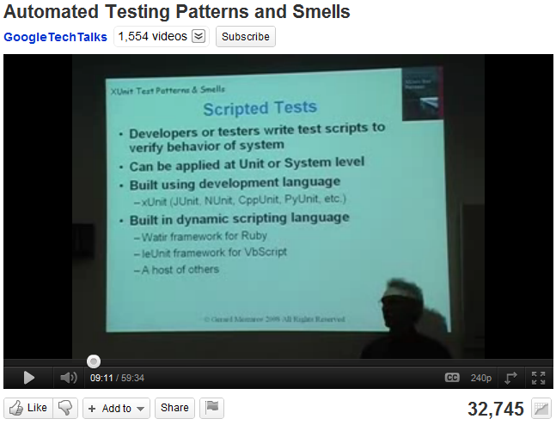
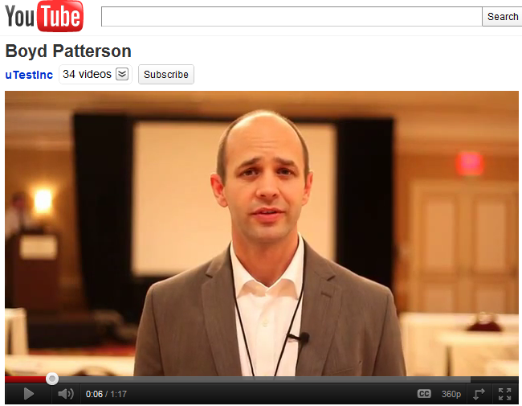
Other Study Materials
Lots of online courses and videos

Slide 27
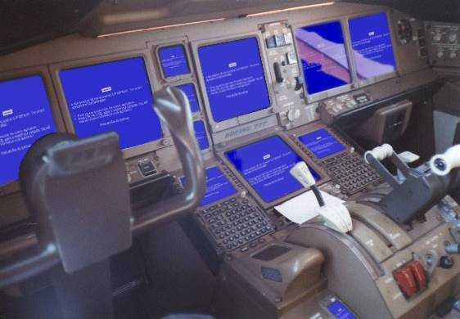
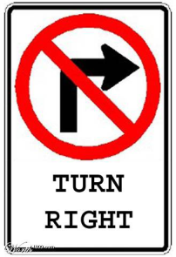
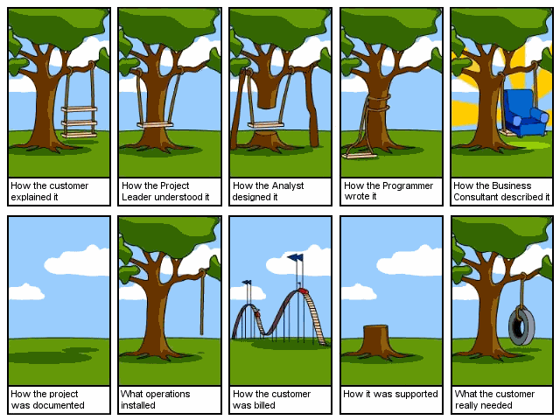

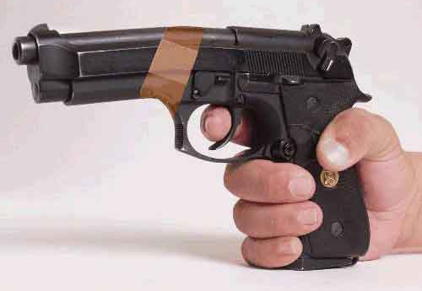
Question to Ask
Do I really need to take this course?
Answer depend on you!
Take this course if you want to avoid these in your career as a software designer, tester and quality controller
Bug Fix
Notes:
More than 50% of our undergraduate software engineering students find job in the area of:
Software testing
Quality control
Software engineers who work on software testing earn on average 20% more than those who do programming and will experience faster growth in company’s hierarchy.
Those with such skills are often hired as consultants

Slide 28
Pre-Assessment Question
We test software to:
Demonstrate conformance to requirements
Find faults in software
Reduce costs in software life cycle
Show system meets user needs
Assess software quality
Prove that the software has no defect

Slide 29
Now Your Turn
What program you are in?
SENG? Comp Science? Other?
How much Software Testing have you done on your own?
Testing your own code
Testing others code
How much Software Testing have you learned in workplace?
Internship/co-op?
What do you expect from this course? (besides a good mark!)

Slide 30
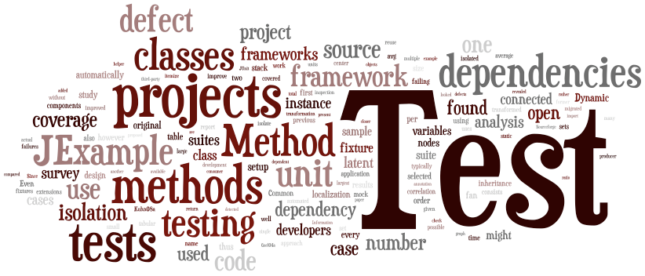
Section 2
Terminology

Slide 31
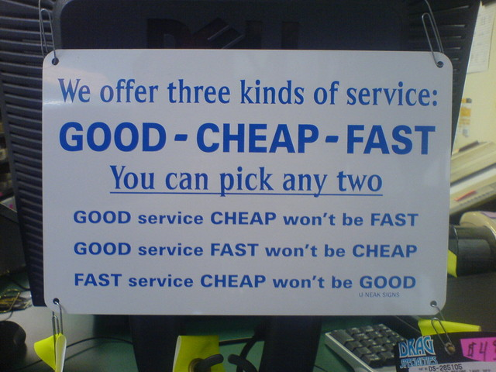
What Affects Quality?
Cost
Quality
Time

Slide 32
What Affects Software Quality?
Time:
Meeting the project deadline.
Reaching the market at the right time.
Cost:
Meeting the anticipated project costs.
Quality (reliability):
Working fine for the designated period on the designated system.
Quality
Cost
Time
People
Technology

Slide 33
Terminology & Scope
Failures
Faults
Errors
The ability of a system to avoid failures that are more frequent or more severe, and outage durations that are longer, than is acceptable to the users.
Threats
Attributes
Means
Models
Availability
Reliability
Safety
Confidentiality
Integrity
Maintainability
Dependability
The ability of a system to deliver service that can justifiably be trusted.
Fault prevention
Fault tolerance
Fault removal
Fault forecasting
Reliability Block Diagram
Fault Tree model
Reliability Graph

Slide 34
Software Testing
Software Testing
Concept
Model
Process
Exploratory
Black-box
White-box
Regression
Unit testing
Integration
etc.
Coverage
Model
Adequacy
Model
etc.
Statistical
Model
Test
Process

Slide 35
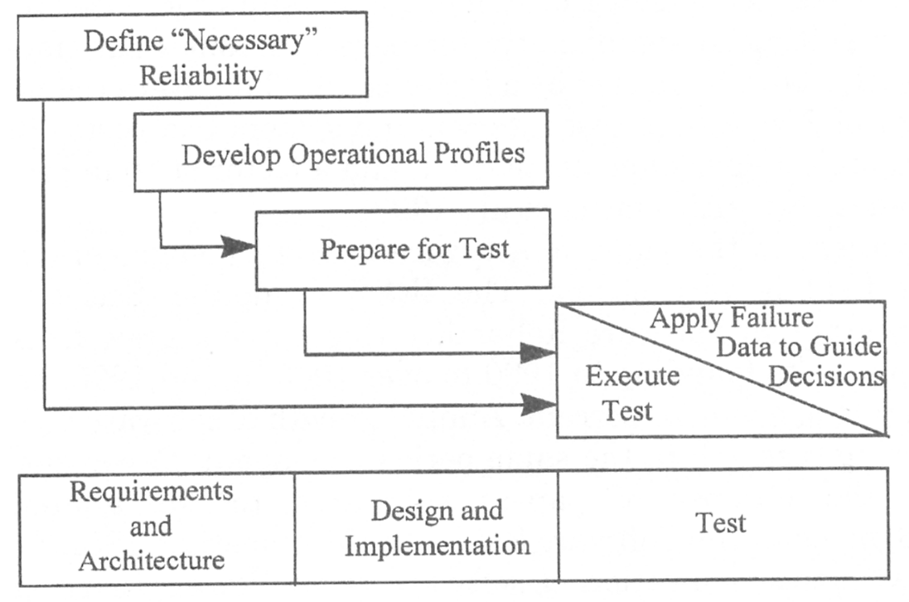
Software Reliability
Software Reliability
Concept
Model
Process
Reliability
Availability
Failure rate
MTTF
Failure density
Etc.
Single
Failure
Model
Multiple
Failure
Model
SRE
Process
Reliability
Growth
Model

Slide 36
Software Quality
Software Quality
Size & Effort
Standards
& Models
Assessment
techniques
Predict size
Predict effort
Predict time
ISO 9126
ISO 25K
etc.
Pre-release
Post-release

Slide 37
Definition: Service
The service delivered by a system is its behaviour as it is perceived by its users; a user is another system (physical, human) that interacts with the former at the service interface.
The function of a system is what the system is intended to do, and is described by the functional specification.
Correct service is delivered when the service implements the system function.
The delivery of incorrect service is a system outage.
A transition from incorrect service to correct service is service restoration.

Slide 38
Dependability: Threats
Error
cause
Fault
cause
Failure
An error is a human action that results in software containing a fault.
A fault (bug) is a cause for either a failure of the program or an internal error (e.g., an incorrect state, incorrect timing). It must be detected and removed.
Among the 3 factors only failure is observable.

Slide 39
Definition: Failure
Failure:
A system failure is an event that occurs when the delivered service deviates from correct service. A failure is thus a transition from correct service to incorrect service, i.e., to not implementing the system function.
Any departure of system behavior in execution from user needs. A failure is caused by a fault and the cause of a fault is usually a human error.
Failure Mode:
The manner in which a fault occurs, i.e., the way in which the element faults.
Failure Effect:
The consequence(s) of a failure mode on an operation, function, status of a system/process/activity/environment. The undesirable outcome of a fault of a system element in a particular mode. ← associated Risk

Slide 40
Failure Intensity & Density
Failure Intensity (failure rate): the rate failures are happening, i.e., number of failures per natural or time unit. Failure intensity is way of expressing system reliability, e.g., 5 failures per hour; 2 failures per 1000 transactions.
Failure Density: failure per KLOC (or per FP) of developed code, e.g., 1 failure per KLOC, 0.2 failure per FP, etc.
For system
end users
For system developers

Slide 41
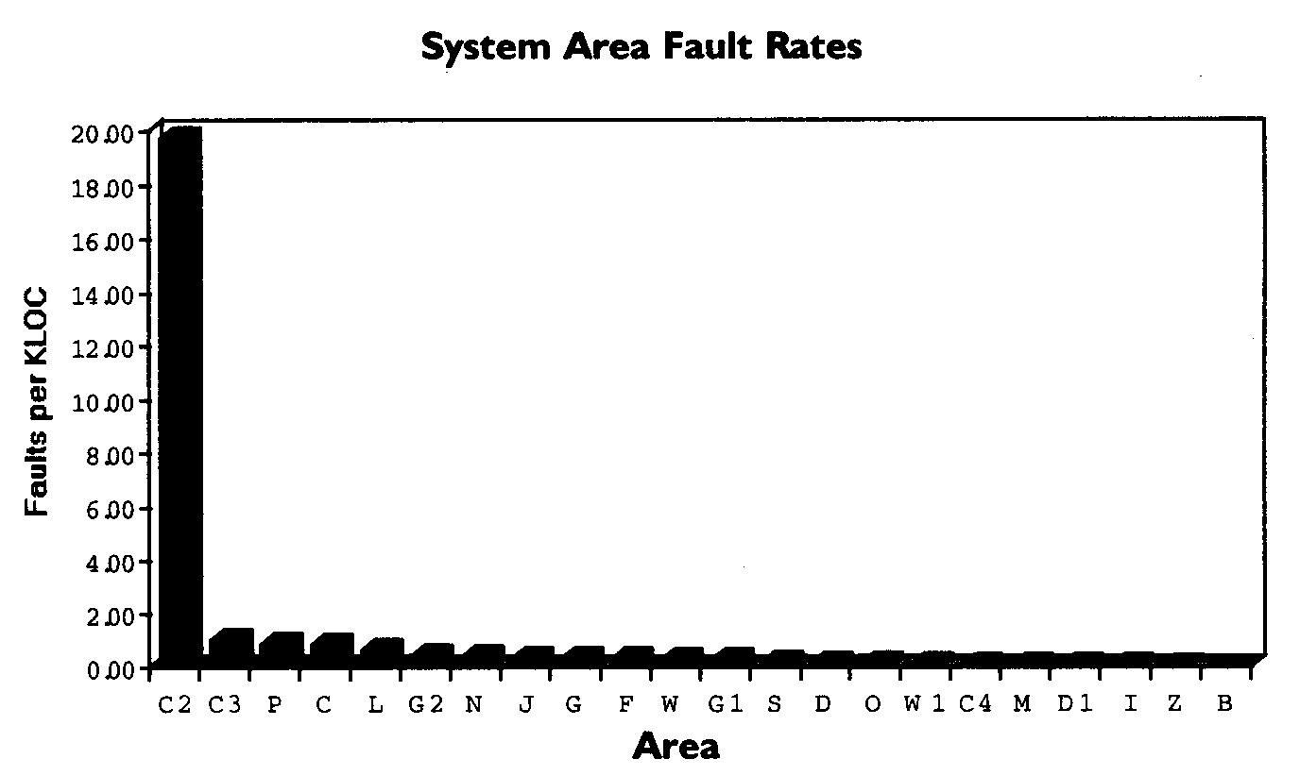
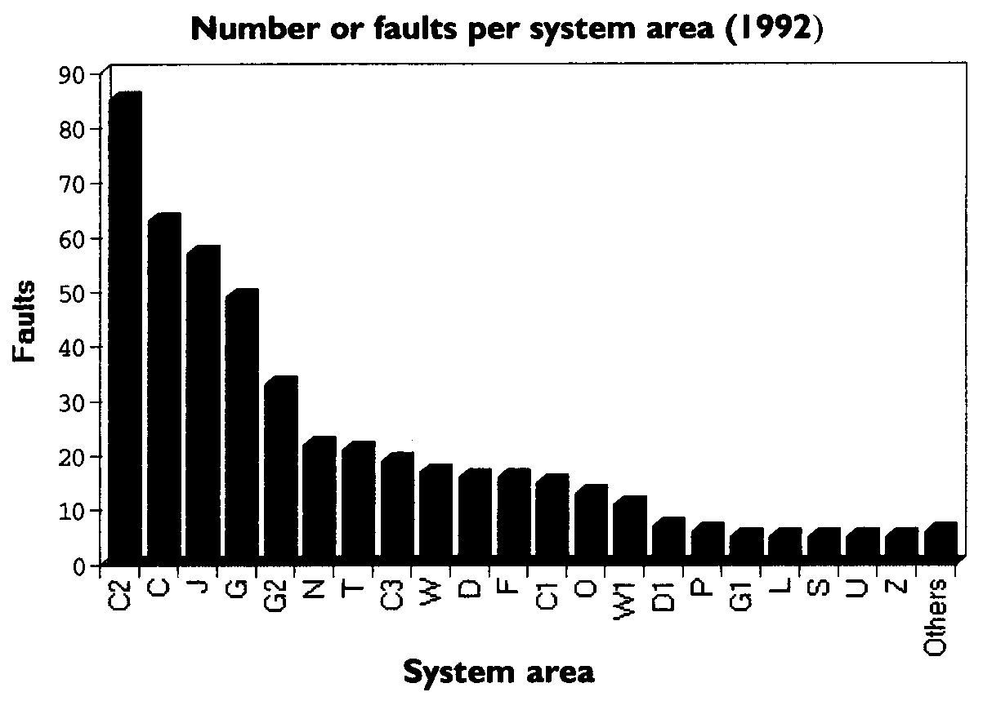
Example: Failure Density
In a software system, measuring number of failures lead to identification of 5 modules.
However, measuring failures per KLOC (Failure Density) leads to identification of only one module.
Example from Fenton’s Book

Slide 42
Failure Density vs. Inspection Effort
Is failure density a good metrics for software quality?
The more bugs found and fixed doesn’t necessarily imply better software quality because the fault injection rate and the effort to fix them may be different.
 |  | Inspection Effort
 |  | Higher | Lower
 | Higher | Good/ Not bad | Worst Case
 | Lower | Best Case | Unsure
Failure
Density

Slide 43
Testing vs. Inspection
Inspections are strict and close examinations conducted on
specifications, design, code, test, and other artifacts.
Inspections allow for defect detection, prevention, and isolation
Start early in life cycle
Testing allows for defect detection
Start later in life cycle
Inspections are up to 20 times more efficient than testing
Code reading detects twice as many defects/hour as testing
80% of development errors are usually found by inspections
Inspections resulted in a 10x reduction in cost of finding errors

Slide 44
Inspections or Testing?
Q. Can inspection replace testing?
Basically no. Inspections could replace testing if and only if all information gleaned through testing could be obtained through inspection. ← usually impossible
Complex interactions in large systems
Software reliability indicator
Nonfunctional requirements: performance, usability, etc.

Slide 45
Definition: Fault
Fault: A fault is a cause for either a failure of the program or an internal error (e.g., an incorrect state, incorrect timing)
A fault must be detected and then removed
Fault can be removed without execution (e.g., code inspection, design review)
Fault removal due to execution depends on the occurrence of associated “failure”.
Occurrence depends on length of execution time and operational profile.
Defect: refers to either fault (cause) or failure (effect)

Slide 46
Definition: Error
Error has two meanings:
A discrepancy between a computed, observed or measured value or condition and the true, specified or theoretically correct value or condition.
A human action that results in software containing a fault.
Human errors are the hardest to detect.

Slide 47
Dependability: Attributes /1
Availability: readiness for correct service
Reliability: continuity of correct service
Safety: absence of catastrophic consequences on the users and the environment
Confidentiality: absence of unauthorized disclosure of information
Integrity: absence of improper system state alterations
Maintainability: ability to undergo repairs and modifications

Slide 48
Dependability: Attributes /2
Dependability attributes may be emphasized to a greater or lesser extent depending on the application: availability is always required, whereas reliability, confidentiality, safety may or may not be required.
Other dependability attributes can be defined as combinations or specializations of the six basic attributes.
Example: Security is the concurrent existence of
Availability for authorized users only;
Confidentiality; and
Integrity with improper taken as meaning unauthorized.

Slide 49
Definition: Availability
Availability: a measure of the delivery of correct service with respect to the alternation of correct and incorrect service

Slide 50
Definition: Reliability /1
Reliability is a measure of the continuous delivery of correct service
Reliability is the probability that a system or a capability of a system functions without failure for a “specified time” or “number of natural units” in a specified environment. (Musa, et al.) Given that the system was functioning properly at the beginning of the time period
Probability of failure-free operation for a specified time in a specified environment for a given purpose (Sommerville)
A recent survey of software consumers revealed that reliability was the most important quality attribute of the application software

Slide 51
Definition: Reliability /2
Three key points:
Reliability depends on how the software is used
Therefore a model of usage is required
Reliability can be improved over time if certain bugs are fixed (reliability growth)
Therefore a trend model (aggregation or regression) is needed
Failures may happen at random time
Therefore a probabilistic model of failure is needed

Slide 52
Definition: Safety
Safety: absence of catastrophic consequences on the users and the environment
Safety is an extension of reliability: safety is reliability with respect to catastrophic failures.
When the state of correct service and the states of incorrect service due to non-catastrophic failure are grouped into a safe state (in the sense of being free from catastrophic damage, not from danger), safety is a measure of continuous safeness, or equivalently, of the time to catastrophic failure.

Slide 53
Definition: Confidentiality
Confidentiality: absence of unauthorized disclosure of information

Slide 54
Definition: Integrity
Integrity: absence of improper system state alterations

Slide 55
Definition: Maintainability
Maintainability: ability to undergo repairs and modifications
Maintainability is a measure of the time to service restoration since the last failure occurrence, or equivalently, measure of the continuous delivery of incorrect service.

Slide 56
Dependability: Means
Fault prevention: how to prevent the occurrence or introduction of faults
Fault tolerance: how to deliver correct service in the presence of faults
Fault removal: how to reduce the number or severity of faults
Fault forecasting: how to estimate the present number, the future incidence, and the likely consequences of faults

Slide 57
Definition: Fault Prevention
To avoid fault occurrences by construction.
Fault prevention is attained by quality control techniques employed during the design and manufacturing of software.
Fault prevention intends to prevent operational physical faults.
Example techniques: design review, modularization, consistency checking, structured programming, etc.

Slide 58
Fault Prevention
Activities:
Requirement review
Design review
Clear code
Establishing standards (ISO 9000-3, etc.)
Using CASE tools with built-in check mechanisms
All these activities are included in ISO 9000-3: Guidelines for application of ISO 9001 to the development, supply and maintenance of software (1991)

Slide 59
Definition: Fault Tolerance
A fault-tolerant computing system is capable of providing specified services in the presence of a bounded number of failures
Use of techniques to enable continued delivery of service during system operation
It is generally implemented by error detection and subsequent system recovery
Based on the principle of:
Act during operation while
Defined during specification and design

Slide 60
Fault Tolerance Process
1. Detection
Identify faults and their causes (errors)
2. Assessment
Assess the extent to which the system state has been damaged or corrupted.
3. Recovery
Remain operational or regain operational status
4. Fault treatment and continued service
Locate and repair the fault to prevent another occurence

Slide 61
Definition: Fault Removal /1
Fault removal is performed both during the development phase, and during the operational life of a system.
Fault removal during the development phase of a system life-cycle consists of three steps:
verification → diagnosis → correction
Verification is the process of checking whether the system adheres to given properties, called the verification conditions. If it does not, the other two steps follow: diagnosing the faults that prevented the verification conditions from being fulfilled, and then performing the necessary corrections.

Slide 62
Definition: Fault Removal /2
After correction, the verification process should be repeated in order to check that fault removal had no undesired consequences; the verification performed at this stage is usually called non-regression verification.
Checking the specification is usually referred to as validation.
Uncovering specification faults can happen at any stage of the development, either during the specification phase itself, or during subsequent phases when evidence is found that the system will not implement its function, or that the implementation cannot be achieved in a cost effective way.

Slide 63
Definition: Fault Forecasting
Fault forecasting is conducted by performing an evaluation of the system behaviour with respect to fault occurrence or activation
Evaluation has two aspects:
qualitative, or ordinal, evaluation, which aims to identify, classify, rank the failure modes, or the event combinations (component failures or environmental conditions) that would lead to system failures
quantitative, or probabilistic, evaluation, which aims to evaluate in terms of probabilities the extent to which some of the attributes of dependability are satisfied; those attributes are then viewed as measures of dependability

